Slide 1

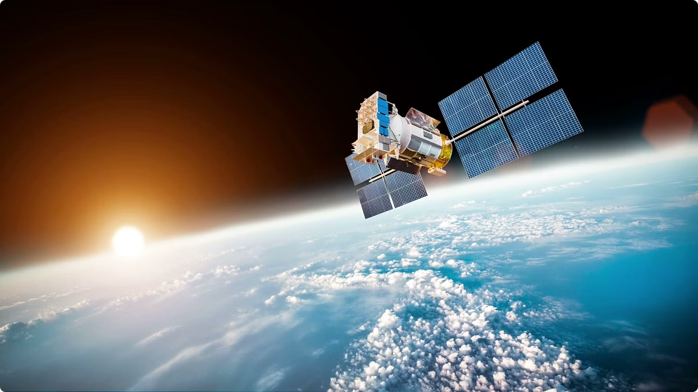

Introduction to Remote Sensing, Electromagnetic Radiation, and its Application in Disaster Management
Welcome to the presentation! Today we'll explore the exciting world of remote sensing, delving into how it utilizes electromagnetic radiation to gather vital information about our planet. We'll focus on its crucial role in disaster management, understanding how it helps us respond effectively to crises.
by Ansh Soni

Slide 2

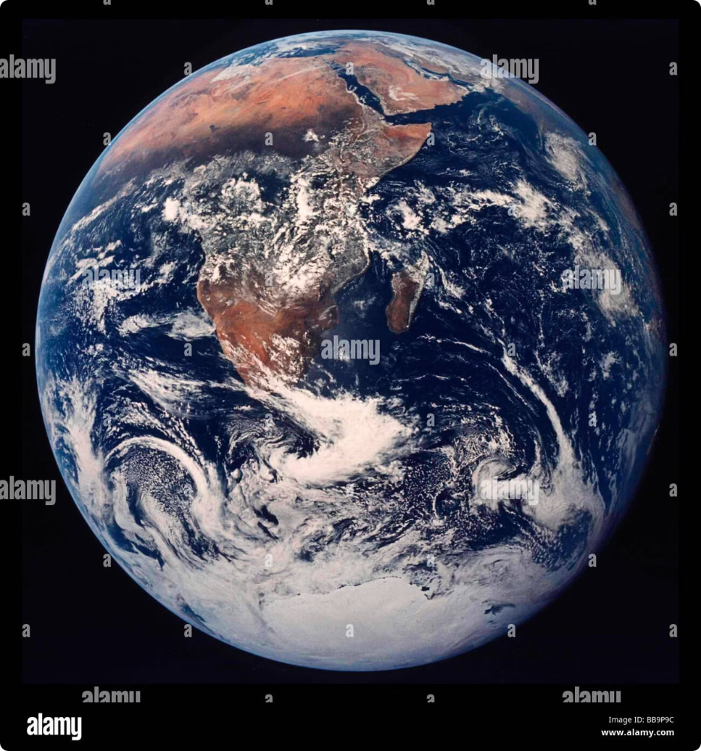
Introduction to Remote Sensing
Remote sensing involves obtaining information about objects or areas without physically touching them.
This is done by capturing reflected or emitted electromagnetic radiation (EMR) from Earth's surface using sensors.
1
Data Collection
2
Diverse Applications
Data can be collected from various platforms such as satellites, aircraft, or even drones.
Remote sensing plays a critical role in fields like agriculture, environmental monitoring, and disaster response.

Slide 3
Satellites in Remote Sensing
Satellites are key players in remote sensing, offering a comprehensive and consistent view of Earth.
They carry specialized sensors that capture images and data from various vantage points, providing valuable information.
Orbit Types
Sensor Types
Satellites orbit Earth in different ways, including geostationary and polar orbits.
Different sensors are designed to detect various wavelengths of EMR, providing diverse data.

Slide 4


Sensors in Remote Sensing
Sensors are the heart of remote sensing, detecting and measuring EMR to capture information.
They operate based on principles of electromagnetic radiation and can be passive or active.
Sensor Type
Description
Passive Sensors
Detect natural EMR emitted or reflected by Earth's surface.
Active Sensors
Emit their own EMR and measure the reflected signal to gather information.

Slide 5





Image Processing Techniques
Remote sensing data often comes in the form of images that need to be processed and analyzed to extract valuable information.
Image processing techniques play a crucial role in enhancing, classifying, and extracting information from these images.
Preprocessing
Corrections are applied to remove noise and distortions from the image.
Enhancement
Techniques like contrast stretching and edge enhancement improve image clarity and details.
Classification
Grouping pixels into different categories based on their spectral characteristics.

Slide 6

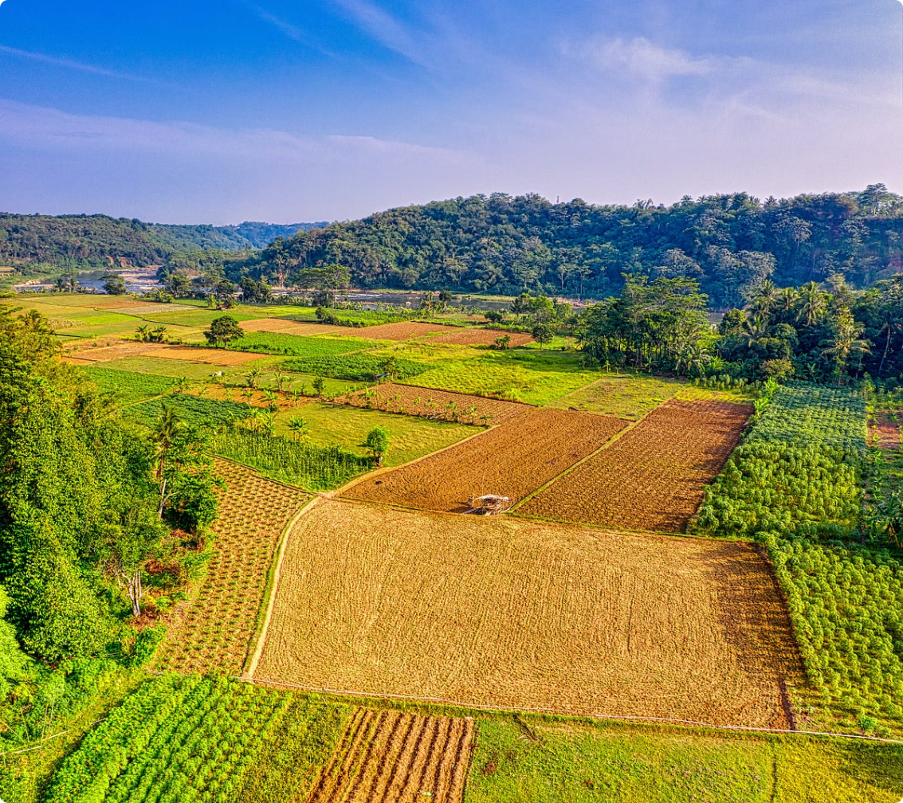

Image Processing Techniques-enhancement, classification.
Image processing involves a series of techniques to enhance, classify, and analyze images.
These techniques are essential for extracting meaningful information from raw remote sensing data.
Enhancement
Classification
Techniques like histogram equalization and spatial filtering enhance the visual quality and clarity of the image.
Classifying pixels based on their spectral characteristics allows for identifying different land cover types, such as forests, water bodies, and urban areas.

Slide 7

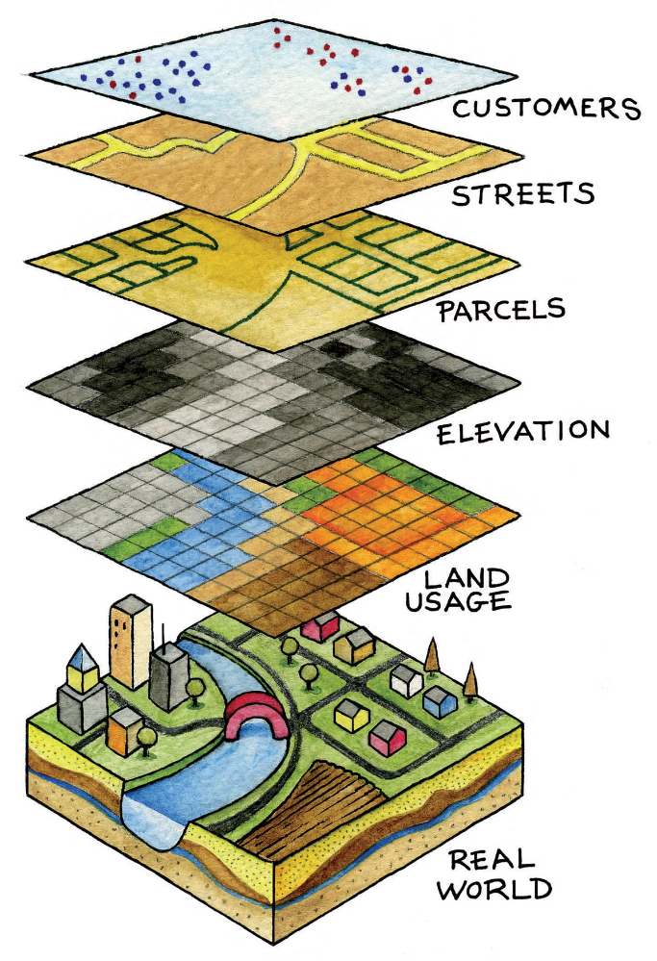
GIS Data Models
Geographic Information Systems (GIS) are powerful tools for managing, analyzing, and visualizing spatial data.
GIS data models are frameworks used to represent real-world geographic features and their relationships within a digital environment.
Vector Model
Raster Model
Represents geographic features as points, lines, and polygons, capturing their precise location and shape.
Represents geographic space as a grid of cells, each representing a specific attribute value.

Slide 8

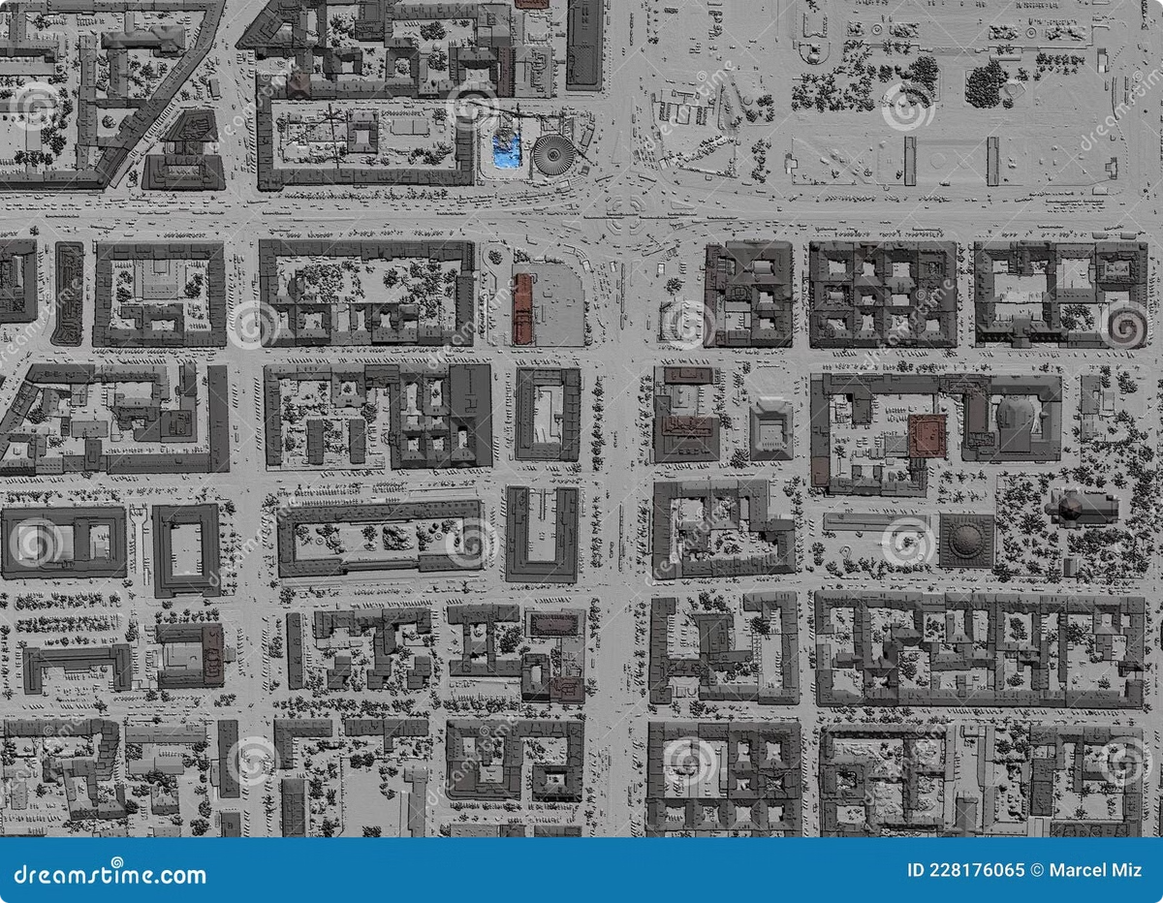
GIS Data Models
GIS data models are crucial for representing and analyzing spatial information.
These models provide a structured way to organize, store, and process geographic data.
1
Vector Model
Suitable for representing discrete features like roads, buildings, and boundaries.
2
Raster Model
Suitable for representing continuous data like elevation, temperature, and rainfall.
3
Object-Oriented Model
Combines aspects of both vector and raster models, allowing for more complex spatial relationships.

Slide 9

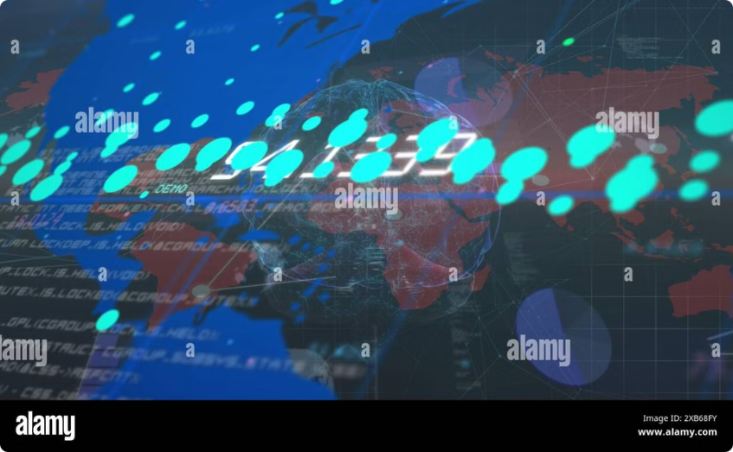
Spatial Data Infrastructure (SDI)
A Spatial Data Infrastructure (SDI) is a framework that enables the coordinated sharing and use of spatial data across organizations and sectors.
SDIs facilitate the integration and analysis of geospatial data, promoting data-driven decision-making.
Data Sharing
Interoperability
SDIs promote data sharing, allowing different organizations to access and utilize common geospatial data sets.
They ensure that data from various sources can be integrated and analyzed seamlessly, overcoming data compatibility issues.

Slide 10

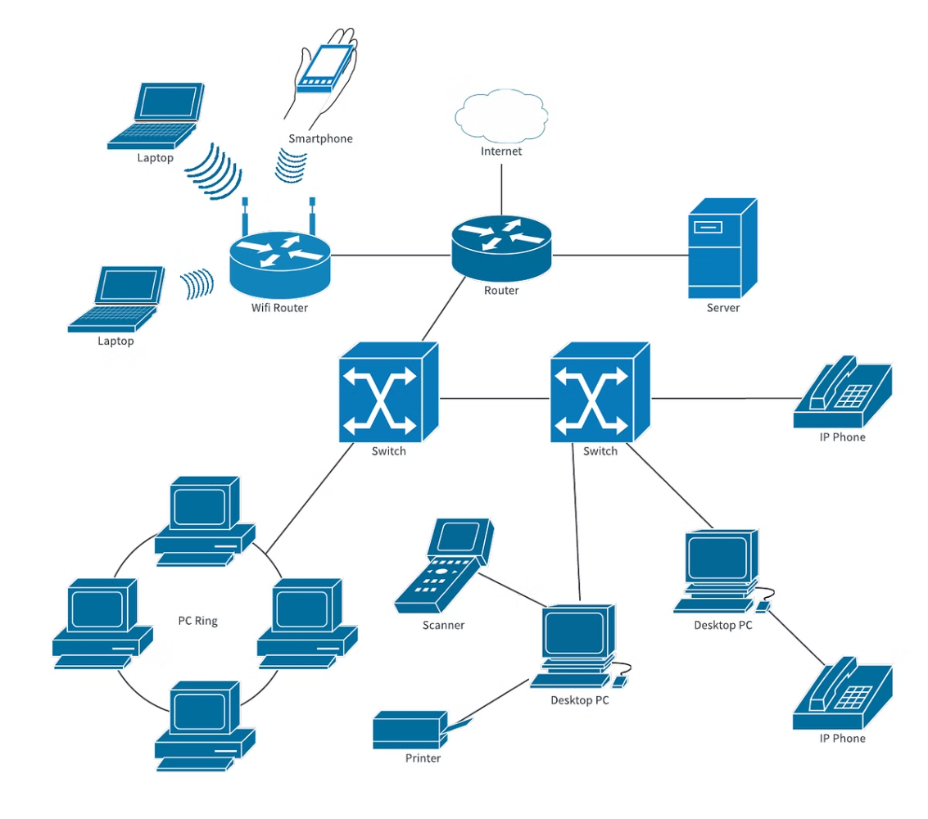
Spatial Data Infrastructure (SDI)
SDIs provide a foundation for a more efficient and coordinated approach to managing and utilizing spatial data.
They play a key role in supporting various applications, including disaster management, urban planning, and environmental monitoring.
1
Data Standards
2
Metadata Management
SDIs promote the use of common data standards, ensuring consistency and interoperability.
They provide mechanisms for documenting and managing metadata, which is crucial for understanding and interpreting data.

